Slide 1
Basic Computer Skill
Memory Unit
Farhana Tazmim Pinki, Assistant Professor, CSE Discipline
Khulna University, Khulna-9208

Slide 2
Memory
Memory may be defined as the devices which is used to store data and information.
Memory components of a computer system are divided into three groups-
    Main Memory or Primary Memory
    Secondary Memory or Auxiliary Memory or Back-up Memory
    Internal Processor Memory

Slide 3
Continue…
Main Memory or Primary memory
  locations in main memory can be directly accessed by the CPU instruction set.
  Used for program and data storage during computer OPERATION
  Example: RAM
Secondary Memory or Auxiliary Memory or Back-Up memory
  Much larger in size but much slower than memory.
  Used for storing system program and large data files which are continually not required by CPU
  Example: Hard Disk

Slide 4
Continue…
Internal Processor Memory
  Usually comprise of small set of high speed registers used as working registers for temporary storage of instructions and data
  Example: Program counter (PC), Accumulator (Acc)

Slide 5
Why Memory
To store program and data during execution
To store program for repetitive use
To store data for future or periodical use.
To store results for execution.

Slide 6
Main Memory
The smallest unit of information that can be stored by a digital computer is called Bit (binary digit).
A collection of four bits is called Nibble.
A combination of eight bits is called a Byte.
Unit of bits that a computer can process at a time is called Word.
The fixed number of bits that a word can store is called the word length which varies from computer to computer.
32 bit computer: Set of bits processed by microprocessor as a unit is 32.

Slide 7
Continue…
A 1KB computer storage has exactly 1024 (2¹⁰) storage locations typically presented as 0000 to 1023.
A computer with 64K storage has 64536 storage locations in memory.
1 MB is roughly 1 Million (Exactly, 2²⁰) bytes of storage.
Roughly 1GB has 1 Billion bytes of storage.
Roughly 1TB has 1 Trillion bytes of storage.
Two kinds of main memory are commonly used in modern computers.
  Semiconductor Memory
  Magnetic Memory

Slide 8
Memory Access
Memory Access
  Instructions or data are read from or written into the memory one word at a time.
  Reading from the memory or writing data into memory is usually called Memory Access.
Access Time
  The performance of a memory device is primarily determined by the rate at which information i.e. one word from the memory is read/written known as Access Time.

Slide 9
Continue..
Each word has a unique address used to identify the location which allows direct access to it.
The address of memory locations is a binary number.
A memory consisting of 8 locations needs 3 bits to represent the address locations.
MEMORY CAPACITY |  |  | NUMBER OF BITS NEEDED TO ADDRESS
1KB | OR | 2¹⁰ bytes | 10
64KB | OR | 2¹⁶ bytes | 16
1MB | OR | 2²⁰ bytes | 20

Slide 10
TYPES OF MEMORY
Volatile memory
  If stored information is destroyed when power goes off.
  Example: Most semiconductor memory (RAM)
Non-volatile memory
  Stored information is preserved when power goes off or power failure.
  Most Magnetic Memory (disk)

Slide 11
Continue…
Serial access memory
- storage locations can be accessed in only in certain pre-defined sequence
- Example: Magnetic tap
Random access memory (RAM)
  If memory locations can be accessed in any order and access time is independent of the location being accessed
Categorized as –
  Static RAM (SRAM)
  Dynamic RAM (DRAM)

Slide 12
Continue…
Static RAM (SRAM)
  Made up of flip flop
  Stores bit as voltage High → 1, Low → 0
  Need no refreshing
  Require greater power supply
  Four times larger in area than DRAM
  Contain less data
  Costlier

Slide 13
Continue…
Dynamic RAM (DRAM)
  Made up of capacitor
  Stores Bit as charge; presence of charge → 1, else → 0
  High density and low power consumptions
  Required refreshing logic to charge the capacitor periodically
  Smaller area
  Less costly

Slide 14
Continue…
Read Only Memory (ROM)
  There are some random access memories in which data are permanently recorded during fabrication itself.
  The memory only allows information stored into it to be read and would not permit any writing or modification by users.
  All microcomputers have at least one ROM unit that contains a small program called BOOTSTRAP LOADER.
  This program is automatically copied into primary storage when a computer is powered up and being to execute.
  This program is responsible for reading in a copy of the operating system from a secondary storage device.

Slide 15
Continue…
Programmable ROM (PROM)
- Special types of ROMs
- PROM enables the user to enter the contents using special equipment called PROM programmer
- But once programmed, it cannot be altered further

Slide 16
Continue…
Erasable Programmable ROM (EPROM)
- Contents of EPROM can be altered as many times as user likes.
- ultraviolet ray is used for erasing
- erasing process is slow
- full erase of the ROM
Electrically Erasable PROM (EEPROM)
- Contents of EPROM can be altered as many times as user likes.
- electrical pulse is used for erasing
- erasing process is fast
- full or partly erase of the ROM

Slide 17
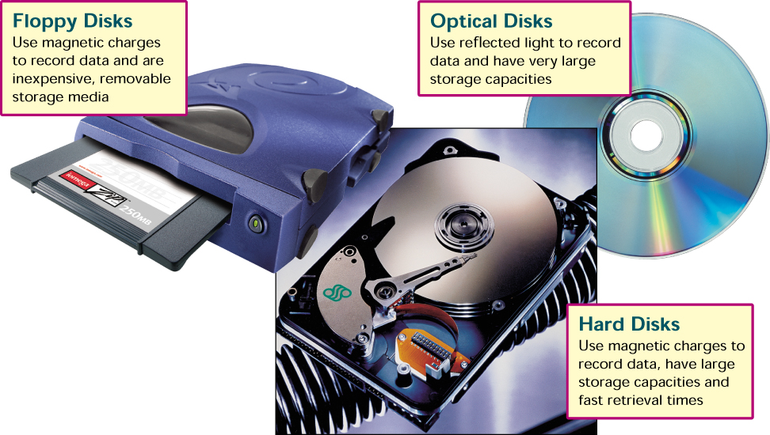
Secondary Storage Devices

Slide 18
Secondary memory
Characteristics:
- Non-volatile storage
- Mass storage
- Cost efficiency
- Lack of direct processing capability
Common secondary memory:
- Magnetic Tape
- Magnetic disk
- Floppy disk
- Optical disk

Slide 19
Primary Vs Secondary memory
 | PRIMARY MEMORY | SECONDARY MEMORY
COST | Expensive | Less expensive
CAPACITY | Limited | Nearly Limited
ACCESS TIME | Billionth of second | Millionth of second
PROCESSING | Directly accessible to the processing unit | Data must be routed through the primary storage
STORAGE MEDIA | Semiconductor magnetic core | Magnetic Tape/ Disk
LOCATION | Within CPU | Outside but connected to CPU

Slide 20
Secondary storage
There are two basic type of storage
  Sequential Access Storage
    To read one particular record in the file all records preceding it must be read
    E.g. magnetic tape
  Direct Access Storage
    Media where an individual record can be located and read immediately without reading any other record.
    Directly retrieved by selecting and using any of the locations on storage media.
    Each storage position must-
      Have unique address
      Can be individually accessed in approximately the same length of time.

Slide 21
Magnetic Tape
Characteristics
  No direct access, but very fast sequential access.
  Resistant to different environmental conditions.
  Easy to transport, store, cheaper than disk.
  Before it was widely used to store application data; nowadays, it’s mostly used for backups or archives

Slide 22
Continue…
Characteristics (Continue..)
A sequence of bits are stored on magnetic tape.
For storage, the tape is wound on a reel.
To access the data, the tape is unwound from one reel to another.
As the tape passes the head, bits of data are read from or written onto the tape

Slide 23
Magnetic Tap
Advantages:
- relatively inexpensive storage medium
- large storage capacity
- compact and can easily be stored on library racks
- old record can be erased and can be used again and again
- reel of tape is also convenient way of carrying information from one place to another

Slide 24
Magnetic Tap
Disadvantages:
- record can be accessed only serially
- information cannot be edited
- dust and uncontrolled humidity or temperature levels can cause tape-reading errors
- data transmission is slow compared to disks
- too much operator’s time would be required to load and unload tapes

Slide 25
Magnetic (Hard) Disk
A hard disk drive (HDD) is a non-volatile, random access device for digital data.
The disk is mounted on a vertical shaft which rotates at a high and constant speed.
Both surfaces of the disk are available for storage and each surface has a read/write head.
An access mechanism moves the read/write head to the desired record to provide direct access.

Slide 26
Optical Disk
latest development in secondary storage is the optical disk
it consists of a rotating disk which is coated with highly reflective material
the data are written by focusing high power laser beam on the surface of the spinning disk
storage capacity is tremendous in comparison to magnetic disk
storage cost is low
Two common types of optical disk:
  - CD, DVD

Slide 27
Continue…
Compact Disks:
Optical format
From 650 MB to 1 GB capacity
Rotation speeds vary
Types
  Read only: CD-ROM
  Write once: CD-R
  Rewriteable: CD-RW
  Picture CDs and Photo CDs

Slide 28
Continue…
Digital Versatile Disc:
Digital Versatile Disk or Digital Video Disk (DVD)
Similar to CDs, but can store more data
Types
  Read only
  Write once
  Rewritable

Slide 29
Storage Hierarchy
Trade-off among the three key characteristics of storage devices:
  cost
  capacity
  access time.
Smaller access time, greater cost per bit.
Greater capacity, smaller cost per bit.
Greater capacity, greater access time.

Slide 30
Continue…
Registers
Cache
Main Memory
Magnetic Disk
Magnetic Tape
Optical Disk
A typical storage hierarchy ladder

Slide 31
Continue…
From top to down the hierarchy, followings occur
  Decreasing cost per bit.
  Increasing capacity.
  Increasing access time.
The smaller, more expensive, faster memories are supplemented by larger, cheaper, slower memories.

Slide 32
Thank You!

